Slide 1

introduction
Get “feel,” “big picture,” introduction to terminology
Overview/roadmap:
What is the Internet? What is a protocol?
Network edge: hosts, access network, physical media
Network core: packet/circuit switching, internet structure
Performance: loss, delay, throughput
Protocol layers, service models
Security
History, yesterday, what do you remember

Slide 2
Activity 1.1
on 3, everyone should read the following text loudly (while you reading try to listen to the others too):
Hi, how are you doing today?
My name is [mention your name]
I enrolled in the class to learn about computer networking
Today is going to be my first in learning computer networking

Slide 3
Activity 1.2
on 3, everyone should read the following text loudly (while you reading try to listen to the others too):
Hi, how are you doing today?
My name is [mention your name]
I enrolled in the class to learn about computer networking
Today is going to be my first in learning computer networking

Slide 4
Activity 1.3
Asking the following questions:
what is your name?
what are you learning?
when are we going to finish the semester?
Let’s answer the previous questions differently this time:
One of the TA will answer the questions in their own native language

Slide 5
Human Communication
In the simplest, to communicate we need the following:
at least two people (sender and receiver)
communication link (in-person scenario, air plays the role of the link)
both people should be able to understand each other
both people should be able to communicate properly

Slide 6
















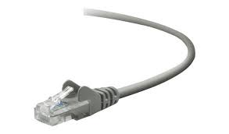
The Internet: a “nuts and bolts” view
Billions of connected computing devices:
hosts = end systems
running network apps at Internet’s “edge”
mobile network
national or global ISP
Packet switches: forward packets (chunks of data)
routers, switches
local or regional ISP
Internet
Communication links
fiber, copper, radio, satellite
transmission rate: bandwidth
home network
content
provider
network
datacenter
network
Networks
collection of devices, routers, links: managed by an organization
enterprise
network

Slide 7
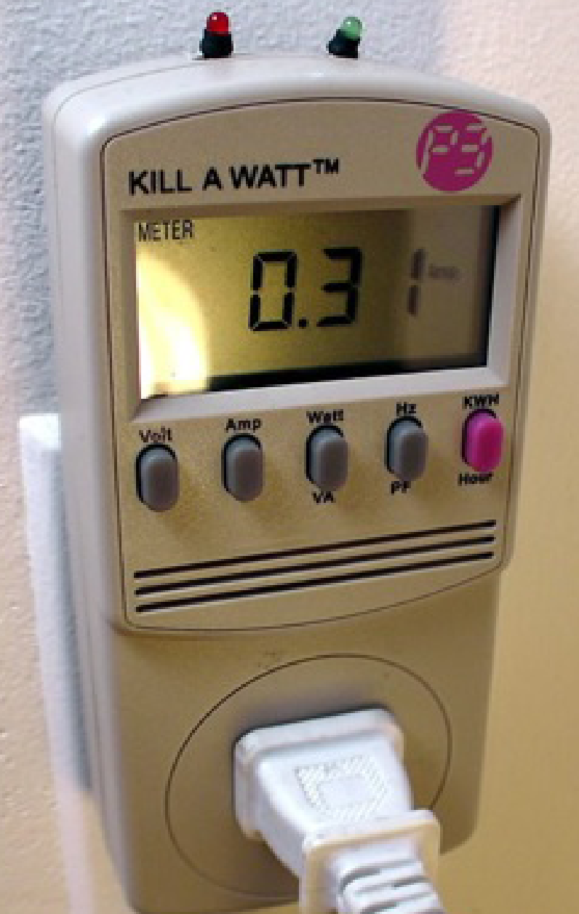

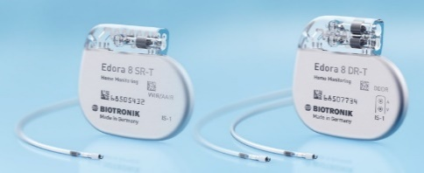





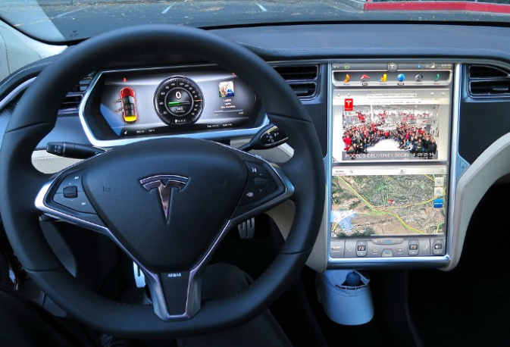





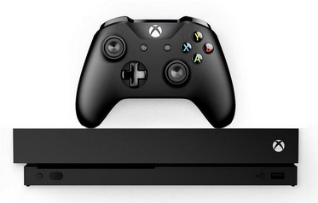

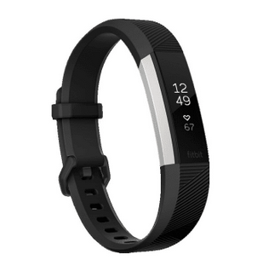
“Fun” Internet-connected devices
Tweet-a-watt:
monitor energy use
bikes
Pacemaker & Monitor
Amazon Echo
Web-enabled toaster +
weather forecaster
IP picture frame
Internet
refrigerator
Slingbox: remote
control cable TV
cars
Security Camera
AR devices
sensorized,
bed
mattress
scooters
Others?
Gaming devices
Internet phones
Fitbit

Slide 8
The Internet: a “nuts and bolts” view
mobile network
4G
Internet: “network of networks”
Interconnected ISPs
national or global ISP
protocols are everywhere
control sending, receiving of messages
e.g., HTTP (Web), streaming video, Skype, TCP, IP, WiFi, 4G, Ethernet
IP
Streaming
video
Skype
local or regional ISP
home network
content
provider
network
Internet standards
RFC: Request for Comments
IETF: Internet Engineering Task Force
HTTP
datacenter
network
Ethernet
TCP
enterprise
network
WiFi

Slide 9
The Internet: a “services” view
Infrastructure that provides services to applications:
Web, streaming video, multimedia teleconferencing, email, games, e-commerce, social media, inter-connected appliances, …
mobile network
national or global ISP
Streaming
video
Skype
local or regional ISP
provides programming interface to distributed applications:
“hooks” allowing sending/receiving apps to “connect” to, use Internet transport service
provides service options, analogous to postal service
home network
content
provider
network
HTTP
datacenter
network
enterprise
network

Slide 10
What’s a protocol?
Human protocols:
“what’s the time?”
“I have a question”
introductions
Network protocols:
computers (devices) rather than humans
all communication activity in Internet governed by protocols
Rules for:
… specific messages sent
… specific actions taken when message received, or other events
Protocols define the format, order of messages sent and received among network entities, and actions taken on message transmission, receipt

Slide 11



What’s a protocol?
A human protocol and a computer network protocol:
Hi
TCP connection
request
Hi
TCP connection
response
Got the
time?
GET http://gaia.cs.umass.edu/kurose_ross
2:00
<file>
time
Q: other human protocols?
Notes:
Explain important points
distributed entities, exchanging messages (governed by protocols)
Time going down
go over definition of protocol (showing format, order of messages sent and received, and actions taken)
We’ll see these kinds of diagrams a lot

Slide 12
A closer look at Internet structure
mobile network
Network edge:
hosts: clients and servers
servers often in data centers
national or global ISP
local or regional ISP
home network
content
provider
network
datacenter
network
enterprise
network

Slide 13
A closer look at Internet structure
mobile network
Network edge:
hosts: clients and servers
servers often in data centers
Access networks, physical media:
wired, wireless communication links
national or global ISP
local or regional ISP
home network
content
provider
network
datacenter
network
enterprise
network

Slide 14
A closer look at Internet structure
mobile network
Network edge:
hosts: clients and servers
servers often in data centers
Access networks, physical media:
wired, wireless communication links
Network core:
interconnected routers
network of networks
national or global ISP
local or regional ISP
home network
content
provider
network
datacenter
network
enterprise
network

Slide 15
Access networks and physical media
Q: How to connect end systems to edge router?
residential access nets
institutional access networks (school, company)
mobile access networks (WiFi, 4G/5G)
mobile network
national or global ISP
local or regional ISP
home network
content
provider
network
datacenter
network
enterprise
network

Slide 16







Access networks: home networks
Wireless and wired
devices
to/from headend or central office
often combined
in single box
cable or DSL modem
WiFi wireless access
point (54, 450 Mbps)
router, firewall, NAT
wired Ethernet (1 Gbps)

Slide 17








Wireless access networks
Shared wireless access network connects end system to router
via base station aka “access point”
Wide-area cellular access networks
provided by mobile, cellular network operator (10’s km)
10’s Mbps
4G cellular networks (5G coming)
Wireless local area networks (WLANs)
typically within or around building (~100 ft)
802.11b/g/n (WiFi): 11, 54, 450 Mbps transmission rate
to Internet
to Internet

Slide 18









Access networks: enterprise networks
Enterprise link to
ISP (Internet)
institutional router
Ethernet
switch
institutional mail,
web servers
companies, universities, etc.
mix of wired, wireless link technologies, connecting a mix of switches and routers (we’ll cover differences shortly)
Ethernet: wired access at 100Mbps, 1Gbps, 10Gbps
WiFi: wireless access points at 11, 54, 450 Mbps

Slide 19
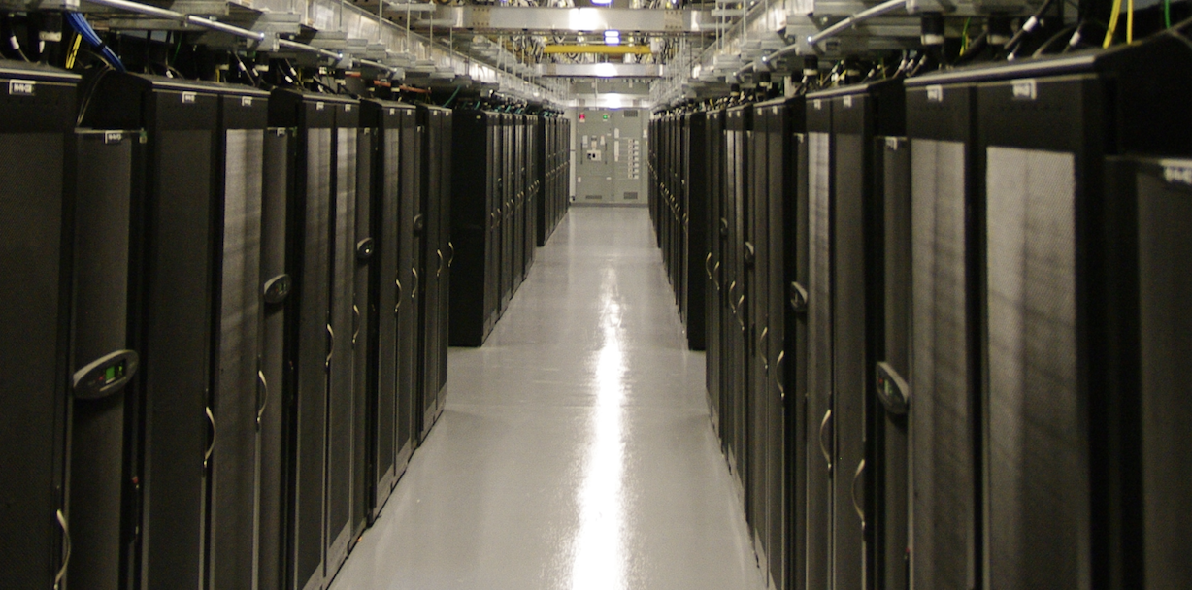
Access networks: data center networks
mobile network
high-bandwidth links (10s to 100s Gbps) connect hundreds to thousands of servers together, and to Internet
national or global ISP
local or regional ISP
home network
content
provider
network
datacenter
network
Courtesy: Massachusetts Green High Performance Computing Center (mghpcc.org)
enterprise
network

Slide 20


Host: sends packets of data
host sending function:
takes application message
breaks into smaller chunks, known as packets, of length L bits
transmits packet into access network at transmission rate R
link transmission rate, aka link capacity, aka link bandwidth
two packets,
L bits each
2
1
host
R: link transmission rate
packet
transmission
delay
time needed to
transmit L-bit
packet into link
L (bits)
R (bits/sec)
=
=

Slide 21
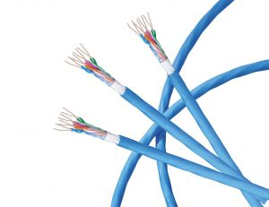
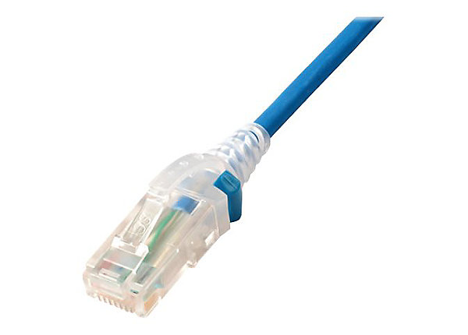
Links: physical media
bit: propagates between transmitter/receiver pairs
physical link: what lies between transmitter & receiver
guided media:
signals propagate in solid media: copper, fiber, coax
unguided media:
signals propagate freely, e.g., radio
Twisted pair (TP)
two insulated copper wires
Category 5: 100 Mbps, 1 Gbps Ethernet
Category 6: 10Gbps Ethernet

Slide 22
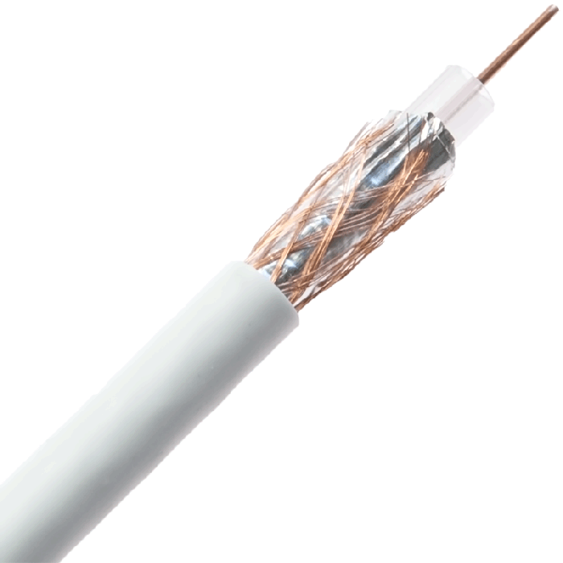
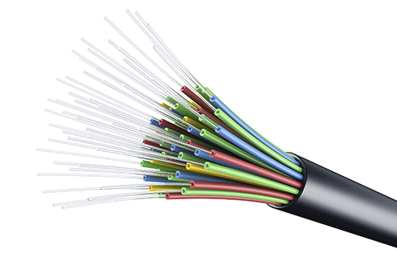
Links: physical media
Coaxial cable:
two concentric copper conductors
bidirectional
broadband:
multiple frequency channels on cable
100’s Mbps per channel
Fiber optic cable:
glass fiber carrying light pulses, each pulse a bit
high-speed operation:
high-speed point-to-point transmission (10’s-100’s Gbps)
low error rate:
repeaters spaced far apart
immune to electromagnetic noise

Slide 23
Links: physical media
Wireless radio
signal carried in various “bands” in electromagnetic spectrum
no physical “wire”
broadcast, “half-duplex” (sender to receiver)
propagation environment effects:
reflection
obstruction by objects
Interference/noise
Radio link types:
Wireless LAN (WiFi)
10-100’s Mbps; 10’s of meters
wide-area (e.g., 4G cellular)
10’s Mbps over ~10 Km
Bluetooth: cable replacement
short distances, limited rates
terrestrial microwave
point-to-point; 45 Mbps channels
satellite
up to 45 Mbps per channel
270 msec end-end delay

Slide 24
The network core
mesh of interconnected routers
packet-switching: hosts break application-layer messages into packets
network forwards packets from one router to the next, across links on path from source to destination
mobile network
national or global ISP
local or regional ISP
home network
content
provider
network
datacenter
network
enterprise
network

Slide 25
Two key network-core functions
routing algorithm
Routing:
global action: determine source-destination paths taken by packets
routing algorithms
routing algorithm
Forwarding:
aka “switching”
local action: move arriving packets from router’s input link to appropriate router output link
local forwarding table
local forwarding table
header value
output link
0100
0101
0111
1001
3
2
2
1
1
3
2
0111
destination address in arriving
packet’s header

Slide 26



Packet-switching: store-and-forward
L bits
per packet
source
3
2
1
destination
R bps
R bps
packet transmission delay: takes L/R seconds to transmit (push out) L-bit packet into link at R bps
store and forward: entire packet must arrive at router before it can be transmitted on next link
One-hop numerical example:
L = 10 Kbits
R = 100 Mbps
one-hop transmission delay = 0.1 msec

Slide 27
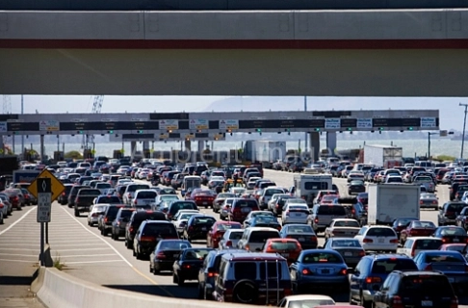

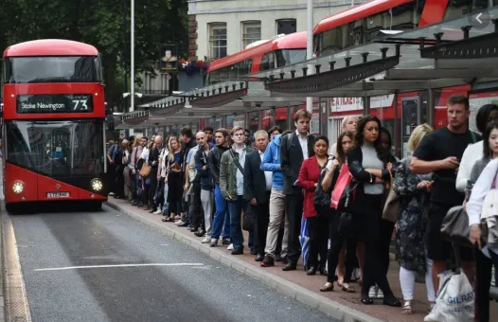
Packet-switching: queueing
R = 100 Mb/s
C
A
R = 1.5 Mb/s
D
B
E
queue of packets
waiting for transmission over output link
Queueing occurs when work arrives faster than it can be serviced:

Slide 28
Packet-switching: queueing
R = 100 Mb/s
C
A
R = 1.5 Mb/s
D
B
E
queue of packets
waiting for transmission over output link
Packet queuing and loss: if arrival rate (in bps) to link exceeds transmission rate (bps) of link for some period of time:
packets will queue, waiting to be transmitted on output link
packets can be dropped (lost) if memory (buffer) in router fills up

Slide 29
Alternative to packet switching: circuit switching
end-end resources allocated to, reserved for “call” between source and destination
in diagram, each link has four circuits.
call gets 2nd circuit in top link and 1st circuit in right link.
dedicated resources: no sharing
circuit-like (guaranteed) performance
circuit segment idle if not used by call (no sharing)
commonly used in traditional telephone networks
* Check out the online interactive exercises for more examples: http://gaia.cs.umass.edu/kurose_ross/interactive

Slide 30
Circuit switching: FDM and TDM
Frequency Division Multiplexing (FDM)
optical, electromagnetic frequencies divided into (narrow) frequency bands
4 users
frequency
each call allocated its own band, can transmit at max rate of that narrow band
time
Time Division Multiplexing (TDM)
time divided into slots
frequency
each call allocated periodic slot(s), can transmit at maximum rate of (wider) frequency band (only) during its time slot(s)
time

Slide 31
Packet switching versus circuit switching
example:
1 Gb/s link
each user:
100 Mb/s when “active”
active 10% of time
…..
N
users
1 Gbps link
Q: how many users can use this network under circuit-switching and packet switching?
circuit-switching: 10 users
packet switching: with 35 users, probability > 10 active at same time is less than .0004 *
Q: how did we get value 0.0004?
A: HW problem (for those with course in probability only)
* Check out the online interactive exercises for more examples: http://gaia.cs.umass.edu/kurose_ross/interactive

Slide 32
Internet structure: a “network of networks”
hosts connect to Internet via access Internet Service Providers (ISPs)
access ISPs in turn must be interconnected
so that any two hosts (anywhere!) can send packets to each other
resulting network of networks is very complex
evolution driven by economics, national policies
mobile network
national or global ISP
local or regional ISP
home network
content
provider
network
datacenter
network
enterprise
network
Let’s take a stepwise approach to describe current Internet structure

Slide 33
Internet structure: a “network of networks”
Question: given millions of access ISPs, how to connect them together?
…
…
access
net
access
net
access
net
access
net
access
net
access
net
access
net
…
…
access
net
access
net
access
net
access
net
access
net
access
net
…
access
net
access
net
…
access
net

Slide 34
Internet structure: a “network of networks”
Question: given millions of access ISPs, how to connect them together?
…
…
access
net
access
net
access
net
access
net
access
net
…
…
access
net
access
net
connecting each access ISP to each other directly doesn’t scale: O(N²) connections.
…
…
…
access
net
access
net
…
access
net
access
net
access
net
…
access
net
…
access
net
access
net
…
access
net

Slide 35
Internet structure: a “network of networks”
Option: connect each access ISP to one global transit ISP?
Customer and provider ISPs have economic agreement.
…
…
access
net
access
net
access
net
access
net
access
net
access
net
access
net
…
…
global ISP
access
net
access
net
access
net
access
net
access
net
access
net
…
access
net
access
net
…
access
net

Slide 36
Internet structure: a “network of networks”
But if one global ISP is viable business, there will be competitors ….
…
…
access
net
access
net
access
net
access
net
access
net
access
net
ISP A
access
net
…
…
access
net
ISP B
access
net
ISP C
access
net
access
net
access
net
access
net
…
access
net
access
net
…
access
net

Slide 37
Internet structure: a “network of networks”
But if one global ISP is viable business, there will be competitors …. who will want to be connected
Internet exchange point
…
…
access
net
access
net
access
net
access
net
access
net
IXP
access
net
access
net
ISP A
…
…
access
net
IXP
ISP B
access
net
ISP C
access
net
access
net
peering link
access
net
access
net
…
access
net
access
net
…
access
net

Slide 38
Internet structure: a “network of networks”
… and regional networks may arise to connect access nets to ISPs
…
…
access
net
access
net
access
net
access
net
access
net
IXP
access
net
access
net
ISP A
…
…
access
net
IXP
ISP B
access
net
ISP C
access
net
access
net
access
net
regional ISP
access
net
…
access
net
access
net
…
access
net

Slide 39
Internet structure: a “network of networks”
… and content provider networks (e.g., Google, Microsoft, Akamai) may run their own network, to bring services, content close to end users
…
…
access
net
access
net
access
net
access
net
access
net
IXP
access
net
access
net
ISP A
…
…
Content provider network
access
net
IXP
ISP B
access
net
ISP C
access
net
access
net
access
net
regional ISP
access
net
…
access
net
access
net
…
access
net

Slide 40
Internet structure: a “network of networks”
Tier 1 ISP
Tier 1 ISP
Google
IXP
IXP
IXP
Regional ISP
Regional ISP
access
ISP
access
ISP
access
ISP
access
ISP
access
ISP
access
ISP
access
ISP
access
ISP
At “center”: small # of well-connected large networks
“tier-1” commercial ISPs (e.g., Level 3, Sprint, AT&T, NTT), national & international coverage
content provider networks (e.g., Google, Facebook): private network that connects its data centers to Internet, often bypassing tier-1, regional ISPs

